Slide 1
IOS Assignment Evaluation
Paper Title : Verification of Producer-Consumer Synchronization in GPU Programs.
Authors : Rahul Sharma
Michael Bauer
Alexa Aiken
Project Team : Akanksha Tonne[PES1201700275]
Rachana Sudhindra Dani[PES1201700950]
Rishika Malla[PES1201700162]
Radhika Sadanand [PES1201701702]
G.Rachana Rao [PES1201700960]
Section : H

Slide 2
Problem Statement
To Verify the correctness of Producer-Consumer Synchronization in GPU Programs .
Notes:
2

Slide 3
Summary of Contribution
Named Barriers.
Warp-Specialized Kernels.
Compute Unified Device Architecture(CUDA)
WEFT
Background and Motivation.

Slide 4
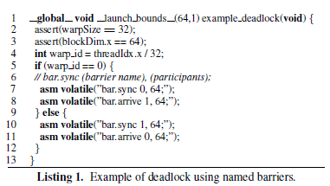
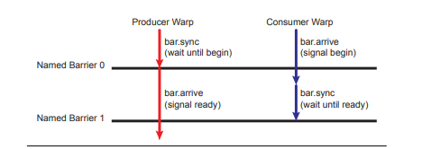
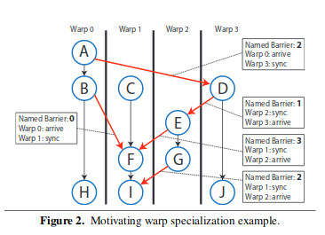
Warp Specialization and Named Barriers
Notes:
4

Slide 5
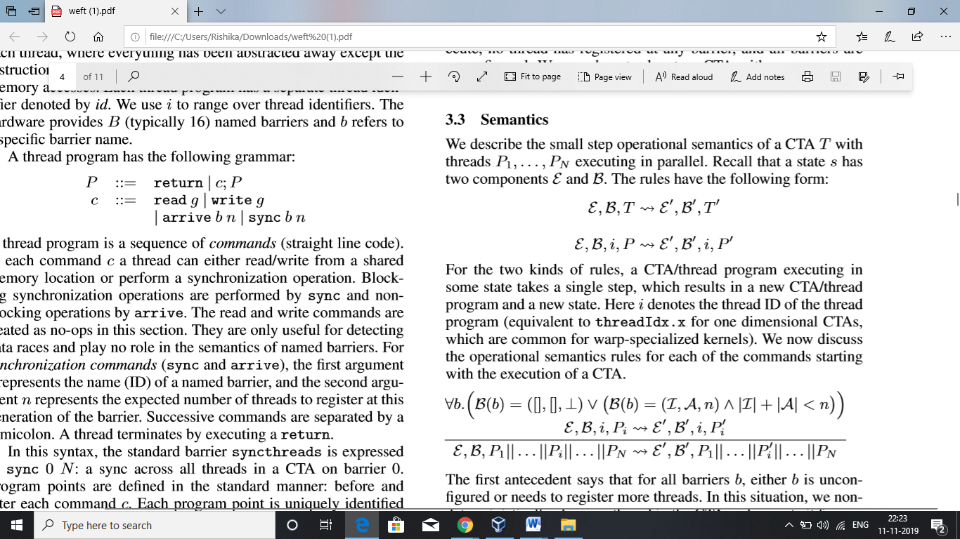
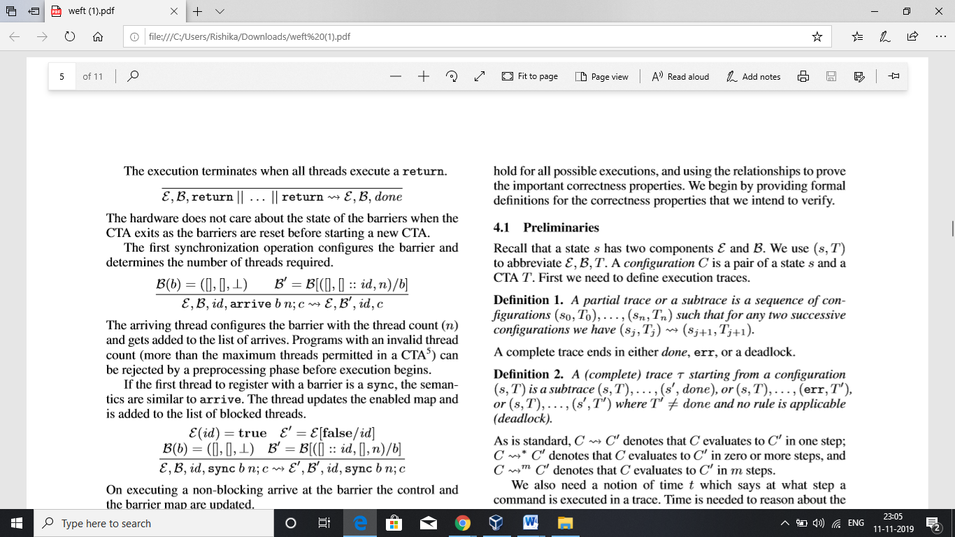
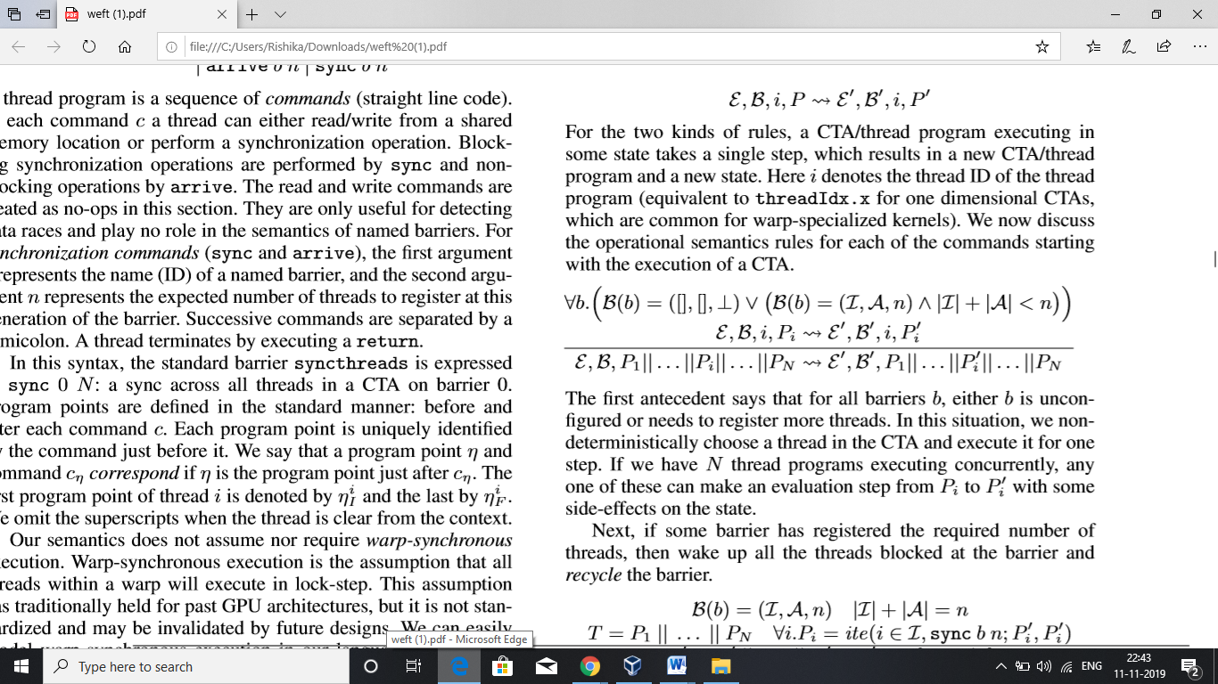
Operational Semantics
State
state ‘s’ of CTA consists of the following
Enabled map ἐ - It maps thread identifiers to Booleans indicating whether a thread is enabled or not.
Barrier map B –It maps the barrier names to a triple consisting of a list I of threads that have synced at the barrier, a list A of threads that have arrived at the barrier, and the thread count
The thread count of unconﬁgured barriers is denoted by ⊥
An empty list of thread identiﬁers is denoted by []
“::” adds a thread to a list
Semantics

Slide 6
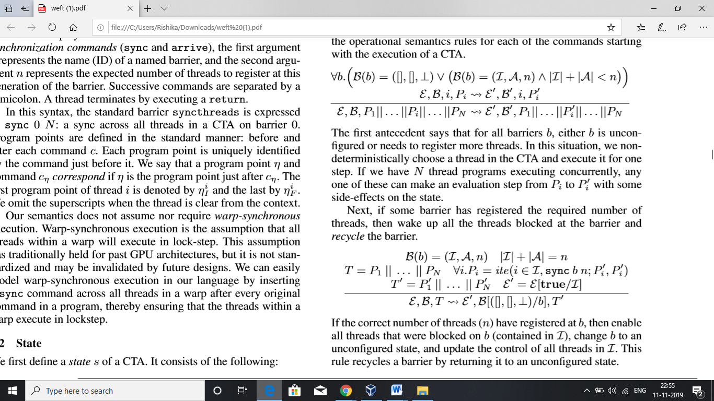
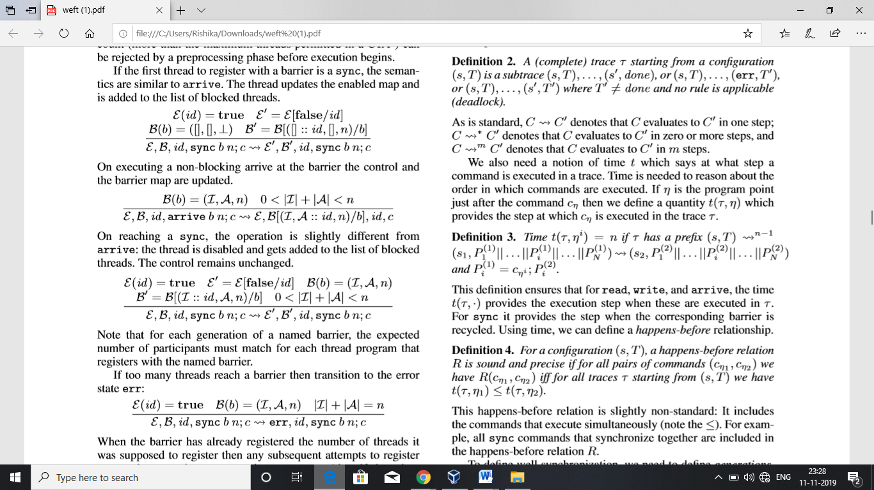
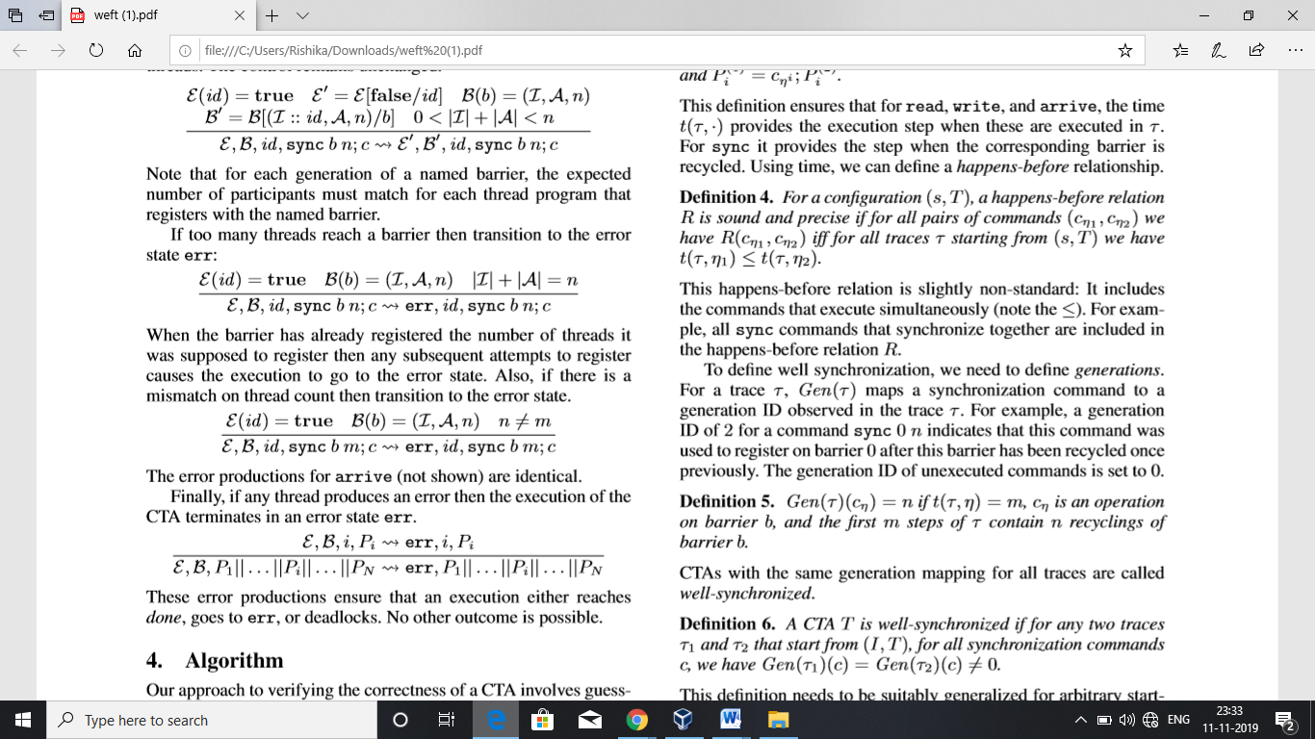

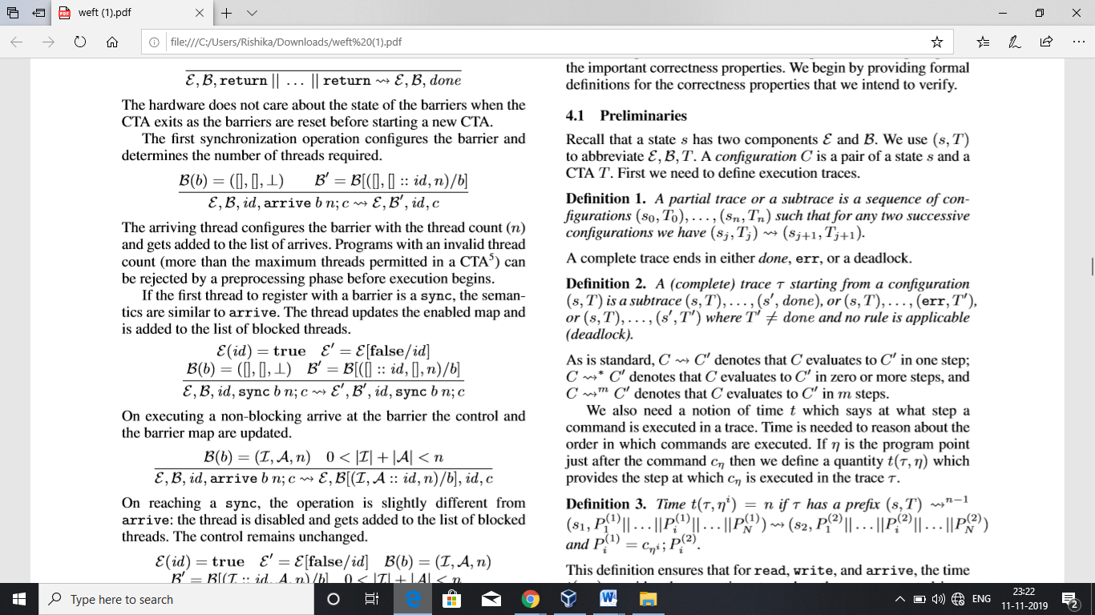
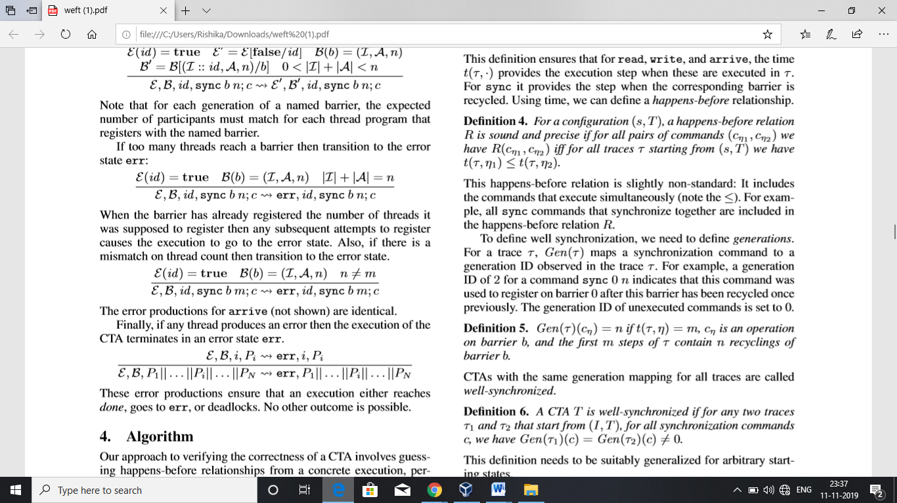

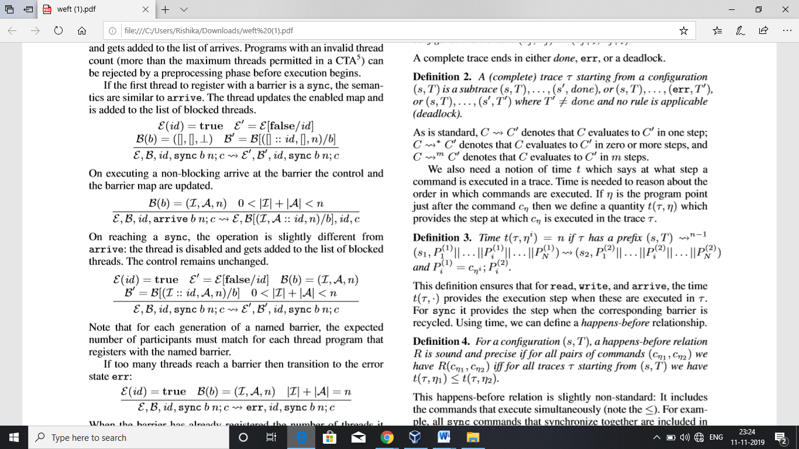

Slide 7
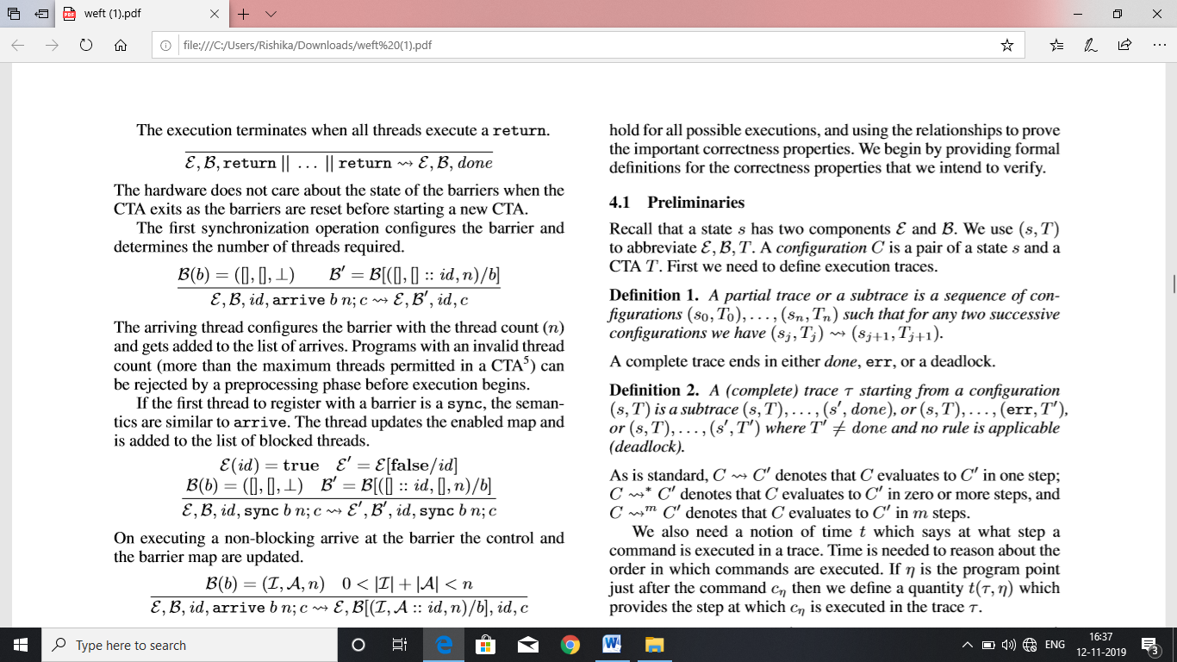
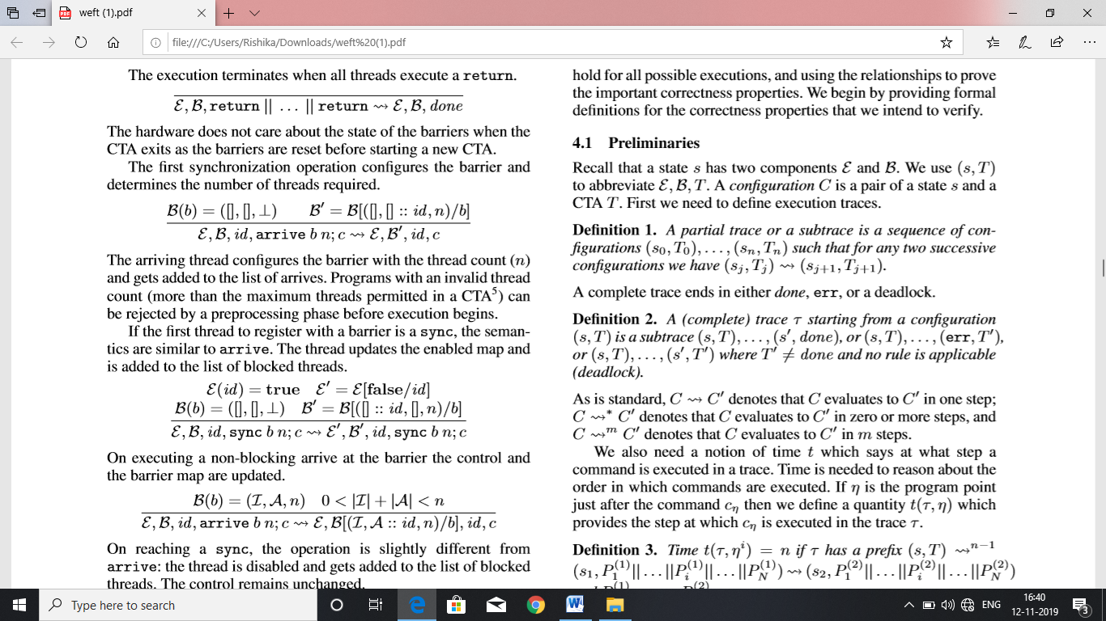
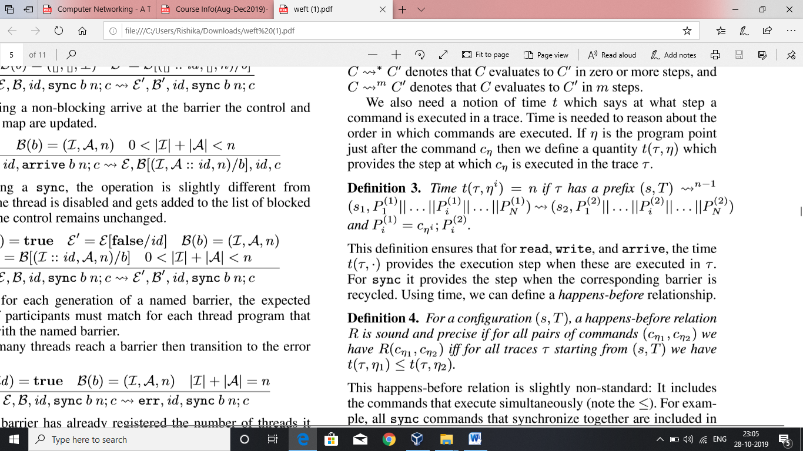
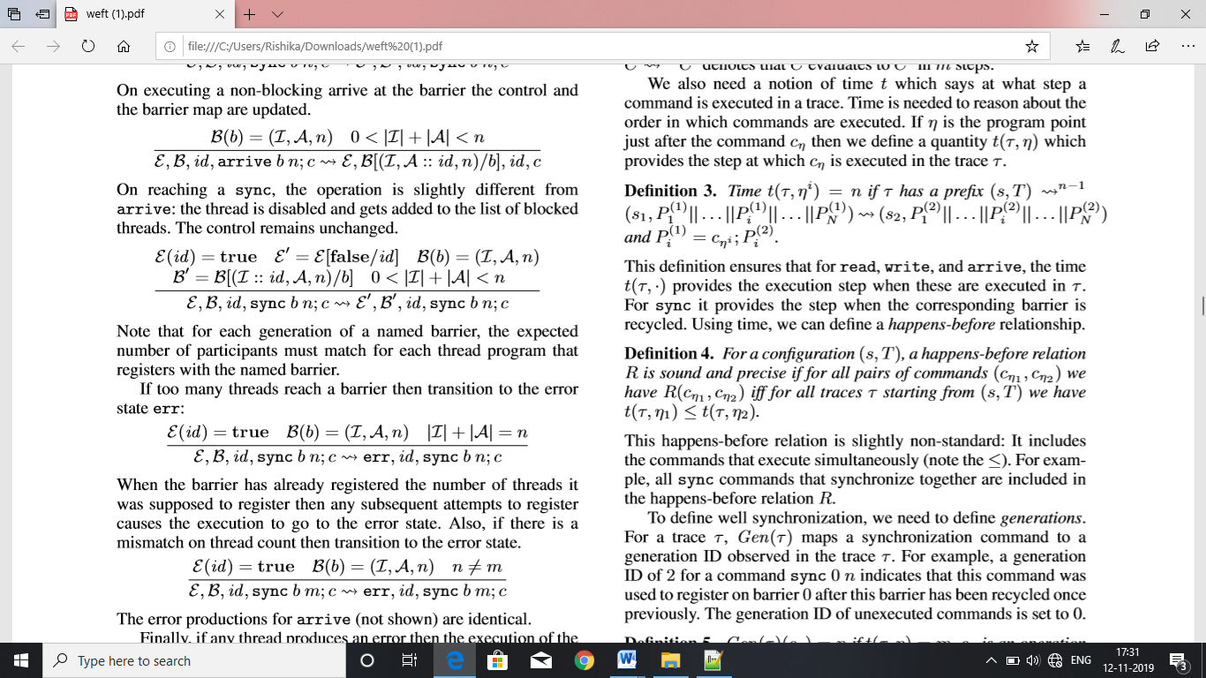
Algorithm

Slide 8
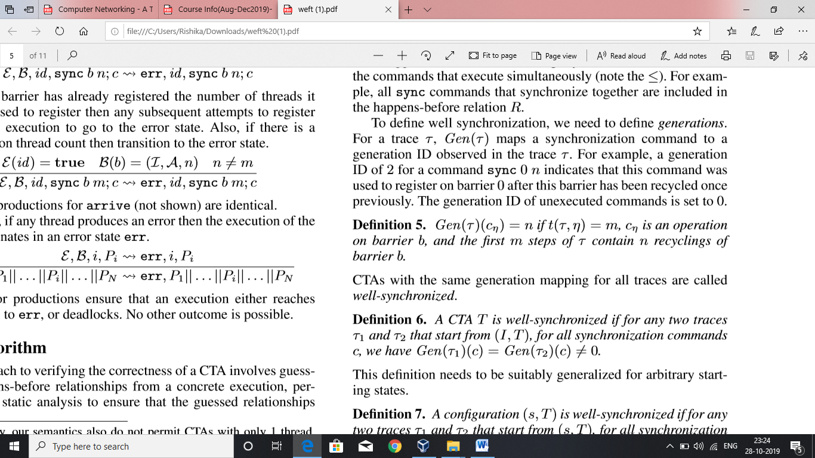

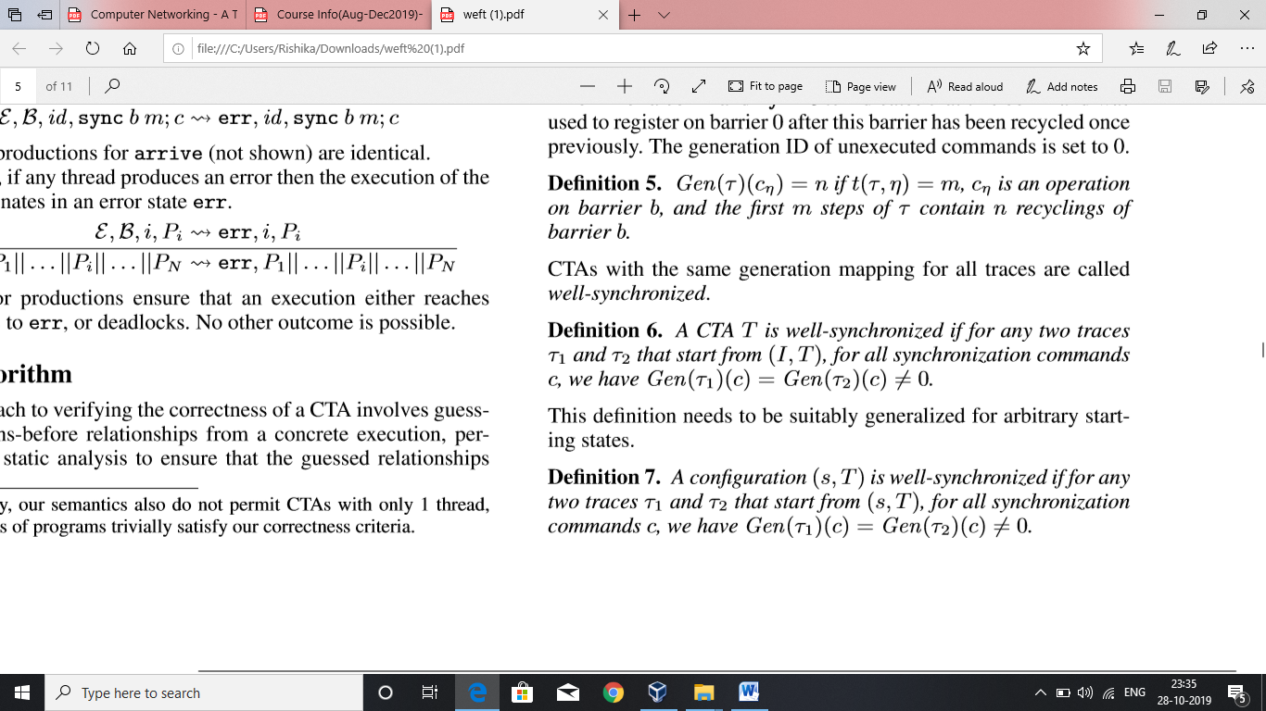
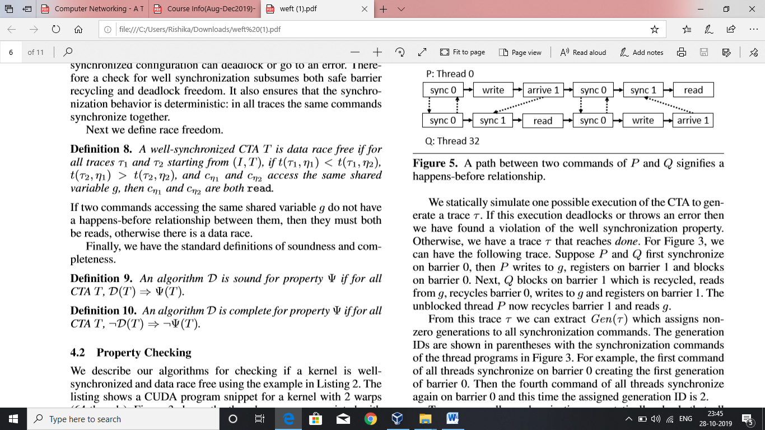
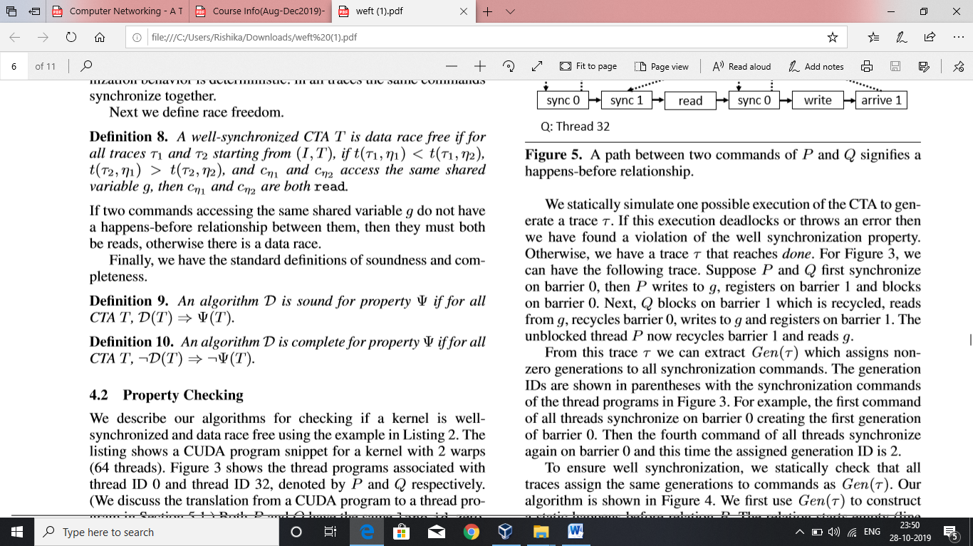

Slide 9
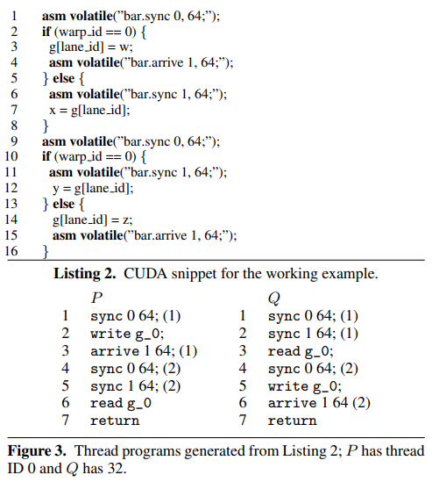
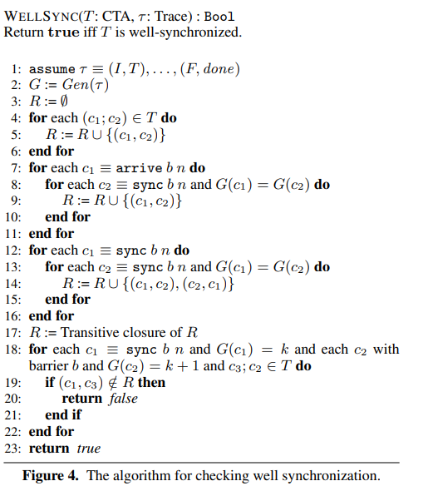

Slide 10
5.1 Emulation of GPU programs in WEFT
Input to the WEFT PTX – assembly language code used in CUDA environment
Emulates each thread in the warp till one of the stopping situations occur
1.No more instructions to emulate
2.Deadlock
3.Not being able to acquire inputs for certain instruction.

Slide 11
Summary of Contribution
5.2 Optimized WEFT Veriﬁcation Algorithm
Synchronization check
2. Barrier Dependence Graph
3. Detection of Data Races

Slide 12
Summary of contribution
Synchronization Check:
Omit all read and write commands
Omit Memory accesses as they do not affect
synchronization
3. Use Algorithm to verify.

Slide 13
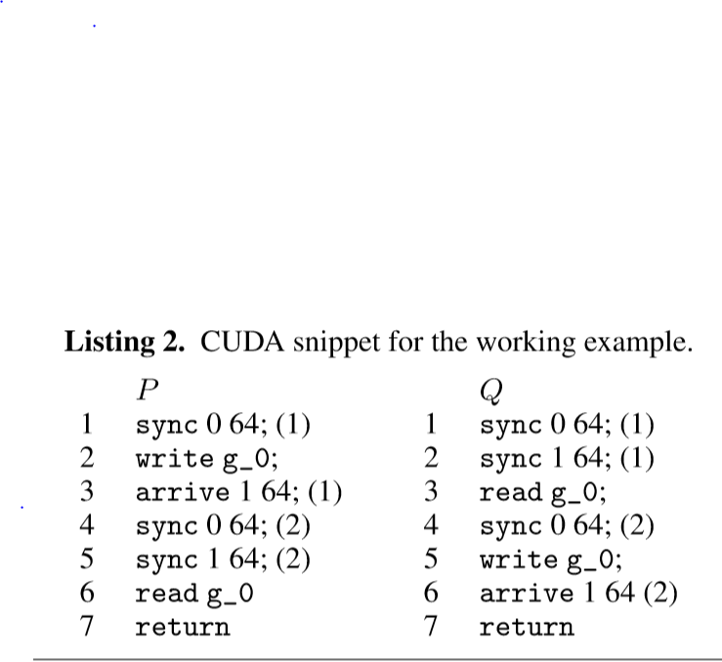
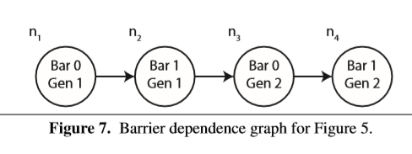
Summary of contribution
Barrier Dependence Graph Acyclic directed graph indicates well synchronization

Slide 14
Summary of contribution
Optimised Algorithm: Data Race Detection
WEFT ﬁrst computes the earliest/latest happens-after/before points reachable in every thread program from each node in the barrier dependence graph.
Happens-before points
2. Earliest Happens-after points

Slide 15
Summary of contribution
Experiments:
WEFT was evaluated on 13 warp-specialized kernels that use the CudaDMA library and 13 warp-specialized kernels that were emitted by the Singe compiler.
CudaDMA : 65-1561 lines of CUDA Singe compiler: 1684-13245 lines of CUDA
All experiments were run on an Intel Xeon X5680 Sandy Bridge processor clocked at 3.33 GHz with 48 GB of memory divided across two NUMA domains.
All experiments using WEFT were run with four threads (two per NUMA domain).

Slide 16
Methodology and Key Results
WEFT Performance
Statistics on each of the kernels including the number of dynamic barriers
1. Total shared memory addresses that are used
2. Total commands in the formal language across all threads
3. The number of thread programs, and the total race tests that were performed.
Performance is measured by the time required to verify each kernel and the total memory required to perform the veriﬁcation.
WEFT reports whether the kernel is well-synchronized and race-free.
In the future, the authors anticipate WEFT will be especially valuable in giving feedback for debugging warp specialized kernels that either deadlock or crash due to a violation of the well-synchronized property during development.
WEFT is able to verify most kernels in a few minutes or less making it practical for use by real developers

Slide 17
Summary
Conclusion:
As GPU usage continues to expand
More task parallelism and larger working sets, warp specialization will become increasingly important for handling challenging kernels that do not ﬁt the standard data-parallel paradigm
Difficult to identify Bugs. Hence, WEFT tool can come handy.
WEFT runs on large, complex, warp-specialized kernels requiring up to billions of checks for race conditions and completes in a few minutes.
Notes:
Fix the references (updated)

